Slide 1
Philadelphia
Revelation 3:7-13
Wallace, Steven J. www.revelationandcreation.com

Slide 2
Philadelphia
Albert Barnes notes, “The country, as viewed from these hills, is extremely magnificent—gardens and vineyards lying at the back and sides of the town, and before it one of the most beautiful and extensive plains of Asia.”
Barnes, Albert, Barnes on the New Testament, “Revelation” Vol. 11, p. 92.

Slide 3
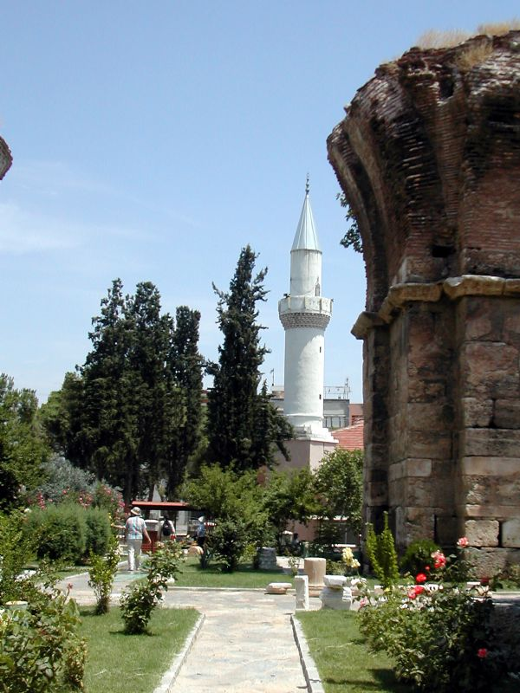
Philadelphia
(www.holylandphotos.org)
Ruins of an old church building ~600 A.D.
28 miles southeast of Sardis

Slide 4
Fleeing Philadelphia
In A.D. 17 the city was leveled by an earthquake; the city was
built on a fault line. "Philadelphia has no trustworthy walls, but daily in one direction or another they keep tottering and falling apart” (Strabo, c. 63 BC - c.21 AD)
Jesus probably alludes to the history
of fleeing out of the city for safety (3:12)

Slide 5
Philadelphia (New Names)
the city had a history of name changes
  in gratitude of the aid given by Tiberius Caesar the citizens changed the name of the city to “Neoceasarea”
  it was then called, “Philadelphia Flavia” during the reign of Vespasian (69-79 A.D.)

Slide 6
The church at Philadelphia
Salutation (3:7)
  He who is holy (cf. 1 Pet. 1:15, 16)
  He who is true (cf. Jn. 14:6)
  He who has the key of David
    Isaiah 22:15-25
    casting down “Shebna” and replacing him with Eliakim (“God raises” or “God sets up”)
    What would this prove regarding Jesus (v. 22, 23; cf. Lk. 1:32, 33; Acts 2:30)?
  He who opens and shuts

Slide 7
The church at Philadelphia
Divine Praise (3:8)
  Jesus knew their works
  to be encouraged by the open door that Jesus gave
    Door was opened at Troas (2 Cor. 2:12)
    Door was opened at Ephesus (1 Cor. 16:8, 9)

Slide 8
The church at Philadelphia
Divine Praise cont.
  little strength
    not a defect
    probably small in numbers, influence, power, etc.
  have kept word
  have not denied my name

Slide 9
The church at Philadelphia
Divine Prescription (3:9-11)
  synagogue of Satan would bow (v. 9)
  “…the hour of trial which shall come upon the whole world, to test those who dwell on the earth” (v. 10)
  holdfast (v.11)

Slide 10
“the hour of trial which shall come upon the whole world” (Rev. 3:10)
Why The Conflict Between Rome and the Church?
  Christianity was unlicensed
  Christianity on Rome’s radar from Nero
  Both are world empires
  Appear relatively the same time
  Both require full allegiance of citizens
  Christianity conflicts with error
  Satan would use Rome to fight Christ

Slide 11
“the hour of trial which shall come upon the whole world” (Rev. 3:10)
Why The Conflict Between Rome and the Church?
  Intolerance (Matt. 12:30; 10:34)
  The explosion of Christianity (Acts 17:6)
  Regular growing group meetings of Christians would make government leaders nervous (Heb. 10:25)
  The caricature of these meetings (Acts 28:22; 1 Pet. 2:11, 12)
    Example: Alexamenos Graffito

Slide 12
“the hour of trial which shall come upon the whole world” (Rev. 3:10)
Why The Conflict Between Rome and the Church?
  The message of Christ the King and His enduring kingdom could be viewed as threatening—the nature of Christ’s rule was misunderstood (Matt. 6:33)
  Considered as atheists who would not worship Caesar (Acts 4:12)

Slide 13
The church at Philadelphia
Divine Promise/Invitation (3:12, 13)
  pillar in the temple of God (cf. 2 Chron. 3:17; Rev. 7:15)
  “And I will write on him the name of My God and the name of the city of My God, the New Jerusalem, which comes down out of heaven from My God”
  new name
  “My God” X 4
    Our God is the God of creation

